Slide 1
Regularization Methods LSTMS & RNNS
Jason Durant – jd3720 & Ashutosh Rawat - at4171

Slide 2
Executive Summary
Goal: Identify regularization methods to increase performance of for RNNs and LSTMS
Solution : Train Two RNN and LSTM Models with varying regularization methods and hyperparameters (e.g. Optimizer, Epochs, Batch Size) in order to construct models with increased robustness.
Value : Overfitting on a variety of tasks can be reduced and more complex RNN and LSTM Models can be utilized for increased performance on a whole host of tasks

Slide 3
Problem Motivation
Often Regularization is applied naively to LSTM and RNN models
Most existing methods of regularization only provide a small gain in performance (Dropout & Batch Normalization)
Large RNNS tends to overfit, as such practical applications of RNNs are relatively small
By identifying regularization techniques which lead to large performance gains, RNNs and LSTMs can have extended use on a wide range of problems

Slide 4
Background Work
Recurrent Neural Network Regularization[1]
Simple regularization technique for LSTM Unites
Regularizing and Optimizing LSTM Language Models[2]
DropConnect on hidden to hide
Recurrent Dropout without Memory Loss[3]
Drop neurons directly in connections w/o loss of long term memory
Weight Regularization with LSTM Networks[4]
Recurrent Batch Normalization[5]
For RNNs and LSTM Networks
Layer Normalization[6]
Effective at stabilizing hidden state dynamics in a RNN

Slide 5
Background Work
Review of Dropout as applied to RNNS[7]
Various approaches to Dropout for RNNs reviewed
Pytorch Implementation of Recurrent Dropout[8]
Model Architectures
PredRNN: Official Implementation Pytorch[9]
ConvLSTM Keras Implementation[10]

Slide 6
Technical Challenges
RNNs are super susceptible to overfitting
Naively applying regularization methods give relatively small improvements for RNNs
Applying conventional dropout does not work well with RNNs because the recurrence amplifies noise
In order to solve this problem dropout is applied only to non recurrent layers
This is done by masking the inputs and outputs to the layer dropout is applied to

Slide 7
Technical Challenges
Choosing the correct metrics by which to analyze the performance of these regularization methods
Using certain variations of Dropout in the LSTM Cells led to memory loss and corruption in LSTM cells
Various regularization methods which could be affected by changing hyperparameters of the model were constrained by computer resources (e.g. batch size)
Regularization methods such as L2 Weight Decay among other have their own hyperparameters which needed to be tested as well adding to the number of combinations

Slide 8
Approach
Trained two RNN and LSTM network :
PredRNN++
ConvLSTM
Moving MNIST dataset is used for training and validation
Dataset contains 10,000 sequences each of length 20 showing 2 digits in 64x64 frames
A subset of the above dataset is used for training due to the computational constraints

Slide 9
Approach
For quantitative comparison we used the following metics:
MSE (Mean Square Error)
SSIM (Structural Similarity Index)
PNSL (Peak Signal to Noise Ratio)
For both the network architecture learning is performed by optimizing the MSE loss
We also focused on different optimization algorithms, as use of regularizers can impede the learning process
Optimizers that performed best were further used to study the effect of regularizers

Slide 10
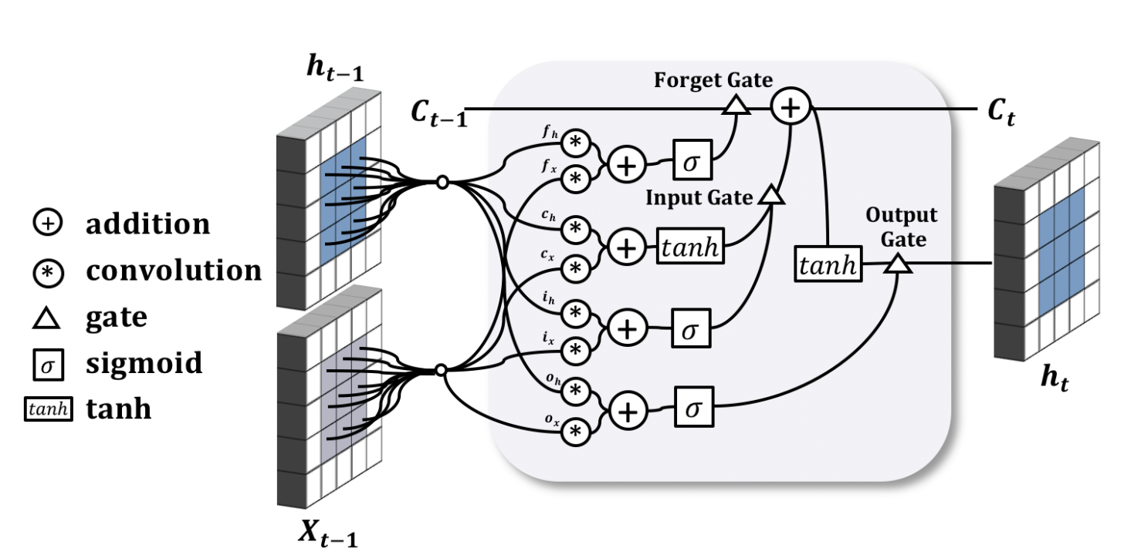
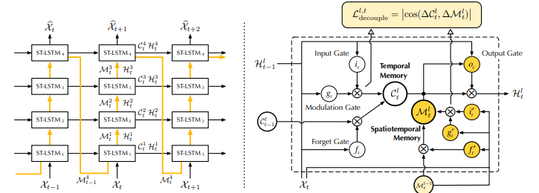
Architecture
ConvLSTM
PredRNN++

Slide 11
Implementation
The PredRNN++ was implemented in Pytorch and ConvLSTM was implemented using Tensorflow
Both the network were trained on GCP using K80 GPU
The networks were trained on Moving MNIST dataset for 20 Epochs, with a batch size of 5
The network were trained for only 20 Epochs because of hardware and time constraints
Lower batch size were used because of memory constraints of the GPU

Slide 12
Experiment Design Flow
Base ConvLSTM and PredRNN models were selected as the model to utilize for analysis
MSE, SSIM, and PSNR metrics were selected to compare the effects of regularization on RNNs and LSTMS based models
Regularization methods were then applied to each of the two models
Metrics were then collected and compared
Qualitative image frames were also retrieved from the regularized models.
Metrics were then evaluated to compare performance between the various regularization methods.

Slide 13
Experimental Evaluation
True
Predicted
Qualitative analysis of the prediction made using ConvLSTM
The results contains the true 10 frames which are made into a gif, it is compared against the predicted frames
The predicted frames are bit blurry but they are able to capture the important information

Slide 14
Experimental Evaluation
Performance of the base network:
* Low value of MSE in ConvLSTM because the images were normalized (0-1)
 | MSE | PSNR (db) | SSIM
PredRNN++ | 218.36 | 16.0535 | 0.7808
ConvLSTM | 0.118 | 42.7138 | 0.9880

Slide 15
Experimental Evaluation
Performance of the different regularization approach on PredRNN++:
 | MSE | SSIM | PSNR
Base | 218.36 | 0.7808 | 16.0535
Layer Norm | 280.00 | 0.7055 | 15.0658
Dropout | 216.23 | 0.7901 | 16.0300
Recurrent Dropout | 215.78 | 0.8012 | 16.0122

Slide 16
Experimental Evaluation
Performance of the different regularization approach on ConvLSTM:
 | MSE | SSIM | PSNR
Base | 0.118 | 0.9880 | 42.7138
Kernel Regularizer (L2) | 0.119 | 0.9662 | 31.09837
Dropout | 0.117 | 0.9892 | 43.7330
Recurrent Dropout | 0.118 | 0.9884 | 43.7605

Slide 17
Conclusion
Through experimentation with various regularization methods, variations of Dropout regularizations performed the best compared to other methods such as weight decay, batch normalization, and layer normalization.
Various methods such as Layer Normalization actually performed significantly worse than the base model performance indicating that not all regularization methods lead to increased performance.
By experimenting with Dropout variations for RNNs and LTSMs in the future there is a possibility that larger and more complex models which take into account memory can be used without concern for overfitting

Slide 18
References
[1] Zaremba, Wojciech, et al. “Recurrent Neural Network Regularization.” ArXiv:1409.2329 [Cs], Feb. 2015. arXiv.org, http://arxiv.org/abs/1409.2329.
[2]Merity, Stephen, et al. “Regularizing and Optimizing LSTM Language Models.” ArXiv:1708.02182 [Cs], Aug. 2017. arXiv.org, http://arxiv.org/abs/1708.02182.
[3]Semeniuta, Stanislau, et al. “Recurrent Dropout without Memory Loss.” ArXiv:1603.05118 [Cs], Aug. 2016. arXiv.org, http://arxiv.org/abs/1603.05118.
[4] Weight Regularization with LSTM Networks for Time Series Forecasting , https://machinelearningmastery.com/use-weight-regularization-lstm-networks-time-series-forecasting/
[5]Cooijmans, Tim, et al. “Recurrent Batch Normalization.” ArXiv:1603.09025 [Cs], Feb. 2017. arXiv.org, http://arxiv.org/abs/1603.09025.
[6]Ba, Jimmy Lei, et al. “Layer Normalization.” ArXiv:1607.06450 [Cs, Stat], July 2016. arXiv.org, http://arxiv.org/abs/1607.06450.
[7]G, Adrian. “A Review of Dropout as Applied to RNNs.” Medium, 24 June 2018, https://adriangcoder.medium.com/a-review-of-dropout-as-applied-to-rnns-72e79ecd5b7b.
[8]“Implementing Recurrent Dropout.” PyTorch Forums, 26 July 2017, https://discuss.pytorch.org/t/implementing-recurrent-dropout/5343.

Slide 19
References
[9]https://github.com/thuml/predrnn-pytorch
[10]https://github.com/keras-team/keras-io/blob/master/examples/vision/conv_lstm.py?fbclid=IwAR3XrzP4jI-Q0O5K-IqquDHpvBekQr-FN4zlJxVvjLp0ic_EWxGDuQF-9Cs

Slide 20
Thank You

